Slide 1
Cyber-Security

Slide 2
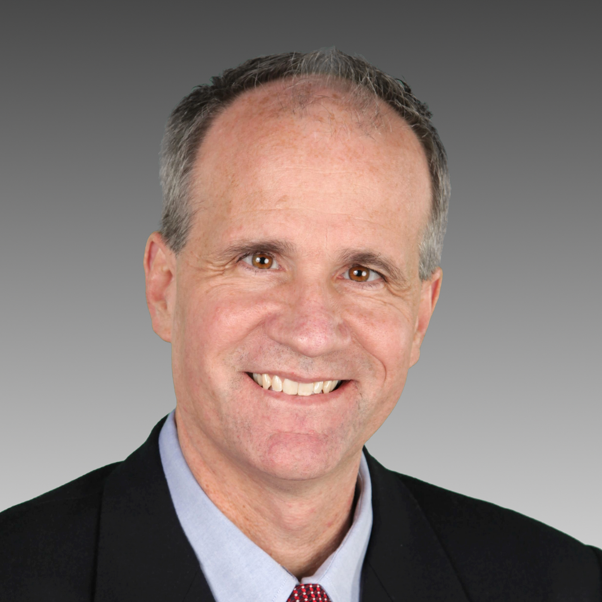
Panel Members
James Kastle
VICE PRESIDENT INFORMATION TECHNOLOGY, CHIEF INFORMATION SECURITY OFFICER (CISO), Conagra brands
Kristi K. Johnson
ASSISTANT SPECIAL AGENT IN CHARGE, FBI-OMAHA FIELD OFFICE
Lesley Slaton Brown
CHIEF DIVERSITY OFFICER, HP, INC.
Rick Haugerud
ASSISTANT VICE PRESIDENT, CHIEF INFORMATION SECURITY OFFICER, UNIVERSITY OF NEBRASKA

Slide 4
Jobs with the best growth potential
Occupation Median Salary
Home Health Aide $21,920
Physical Therapist $84,020
Financial Advisor $89,160
Information Security Analyst* $90,120
Software Engineer $100,690
Medical Services Manager $94,500
Data Scientist $128,240
Registered Nurse $67,490
General & Operations Manager $97,730
Truck Driver $42,260

