Slide 1
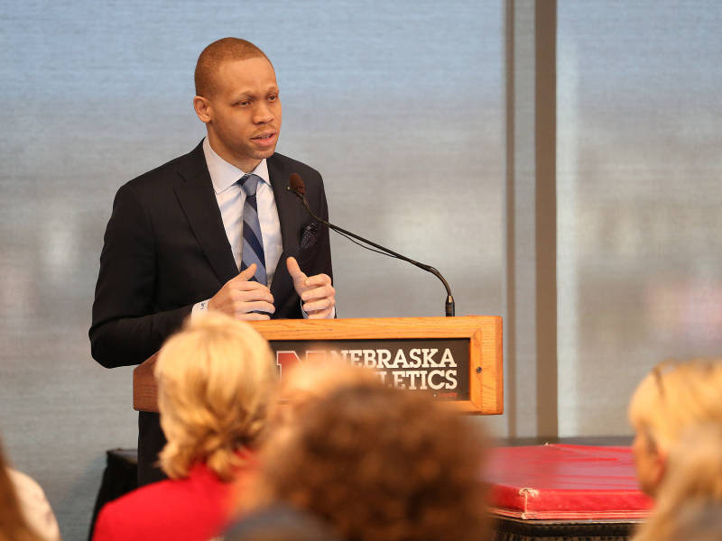
Diversity Wins (Creating A Championship Caliber Environment Through Inclusion
Lawrence J. Chatters, M.A.
Diversity and Inclusion Consultant
Nebraska Athletics
October 19, 2017

Slide 2
What to Expect
My Story
Your Story
Diversity and Inclusion 101
Nebraska Athletics Diversity and Inclusion Initiatives
What you can do to build your program

Slide 3
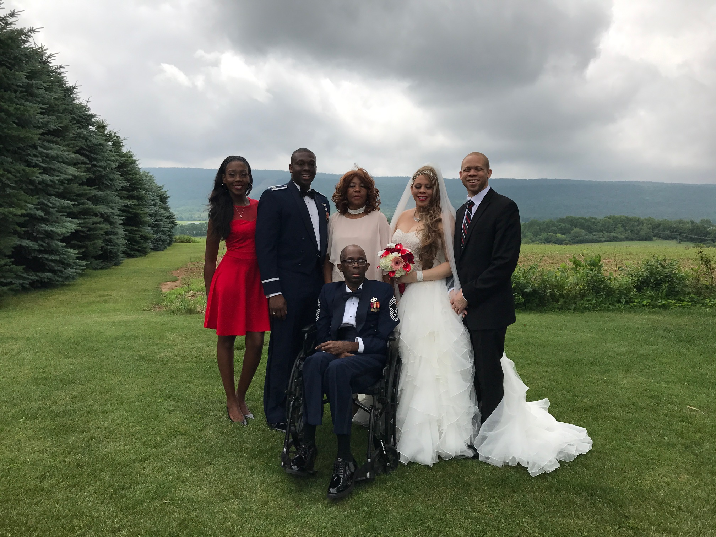
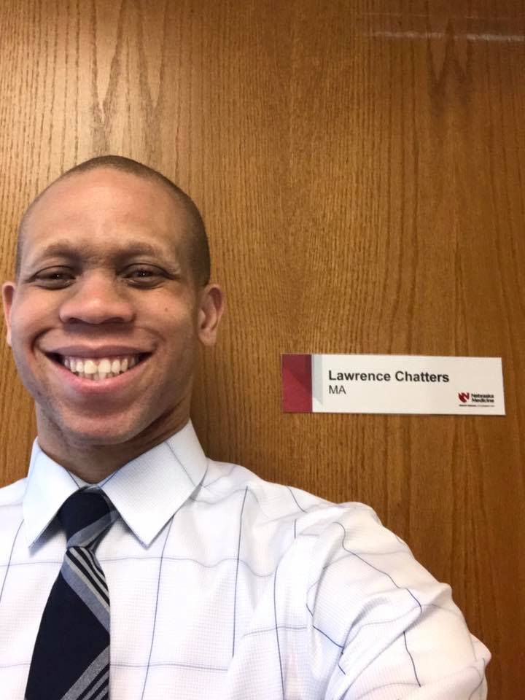
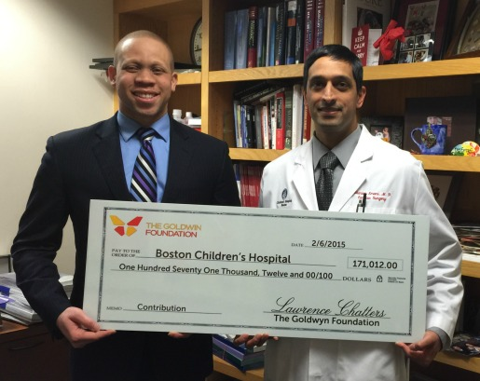
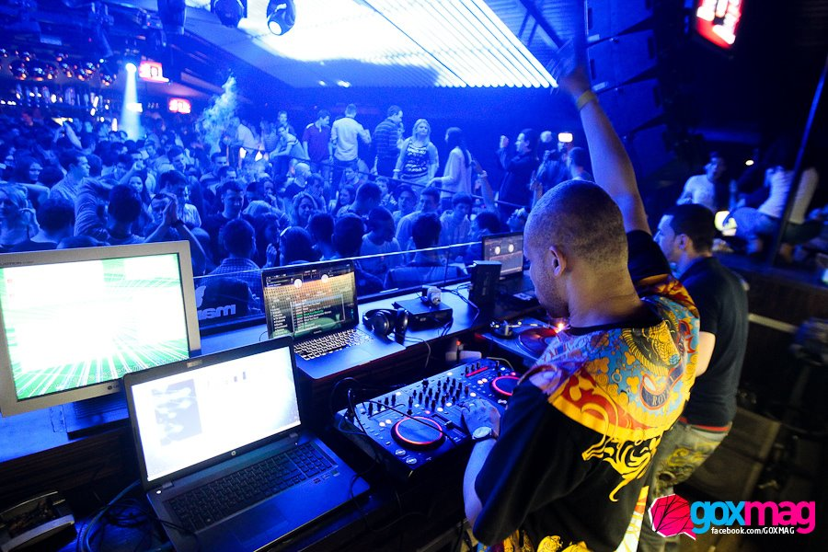
My Story

Slide 4
Let’s Break the Ice! (Your Story)
Your Name and Hometown
Something unique about you
Something you share in common with your new friend
10 Year Dream Plans

Slide 5
Diversity and Inclsuion 101
Diversity is any dimension that can be used to differentiate groups and people from one another. It means respect for and appreciation of differences in ethnicity, gender, age, national origin, disability, sexual orientation, education, socio-economic status and religion.
Inclusion is a state of being valued, respected and supported. It’s about focusing on the needs of every individual and ensuring the right conditions are in place for each person to achieve his or her full potential. Inclusion should be reflected in an organization’s culture, practices and relationships that are in place to support a diverse department.
Diversity provides a richer experience
Inclusion increases retention and facilitates teamwork

Slide 6
Current NU Athletics Inclusion Initiatives
International Student Athlete Orientation
Annual Nebraska Athletics Diversity and Inclusion Summit
Next Steps Field Trips
Husker Athletics Diversity and Inclusion Committee
Inner Circle Collaborative Events-Black History (OASIS) and Women's History Month ( UNL Women’s Center)
BE THE 90 Program

Slide 7
Inclusion in Action!
2017 INCLUSION SUMMIT VIDEO
NEXT STEPS FIELD TRIP

Slide 8
What Can You Do
Ask the right questions
Sustaining workplace equity
Encouraging inclusive behaviors
Ensuring a Diverse and Inclusive Culture

Slide 9
What are the right questions?
How diverse, equitable and inclusive are our hiring practices?
How successful are our onboarding, mentoring and coaching processes?
What do the findings from our exit interviews tell us about retention?
How are our senior leaders engaged in supporting diversity, inclusion and engagement? What about our staff?
To what degree does our employee education and training support diverse employee advancement and retention?
How is our organization involved in diverse communities?
How do we ensure our search process will produce a diverse candidate pool?

Slide 10
Sustaining Workplace Equity

Slide 11
Encouraging Inclusive Behaviors
1. Appreciate
2. Affirm
3. Advocate
4. Sponsor
5. Develop
6. Stretch
7. Mentor 8. Train
9. Coach
10. Feedback
11. Encourage
12. Include
13. Challenge

Slide 12
Ensuring a Diverse and Inclusive Culture
Head (Intellectual Buy-in) (Research Best Practices)
+
Heart ( Emotional Buy-in) (Success Stories)
+
Hands ( Behavioral Effort ) (Be Deliberate)

Slide 13
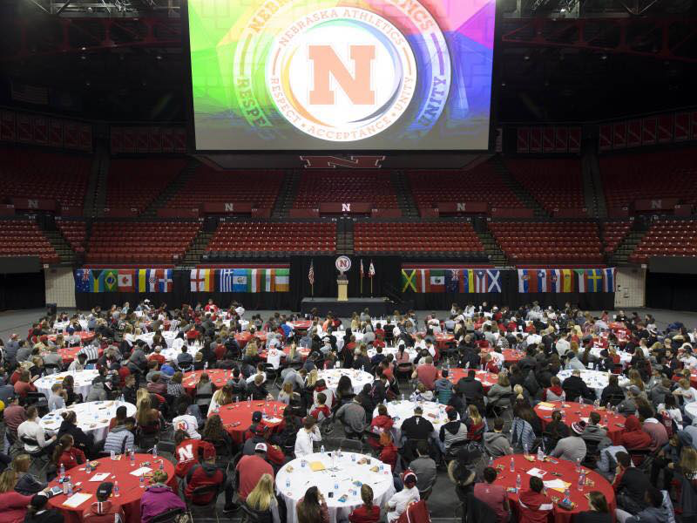
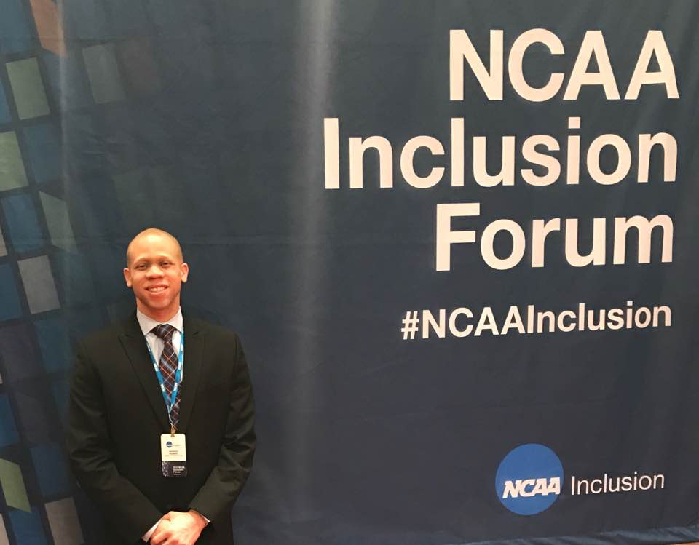
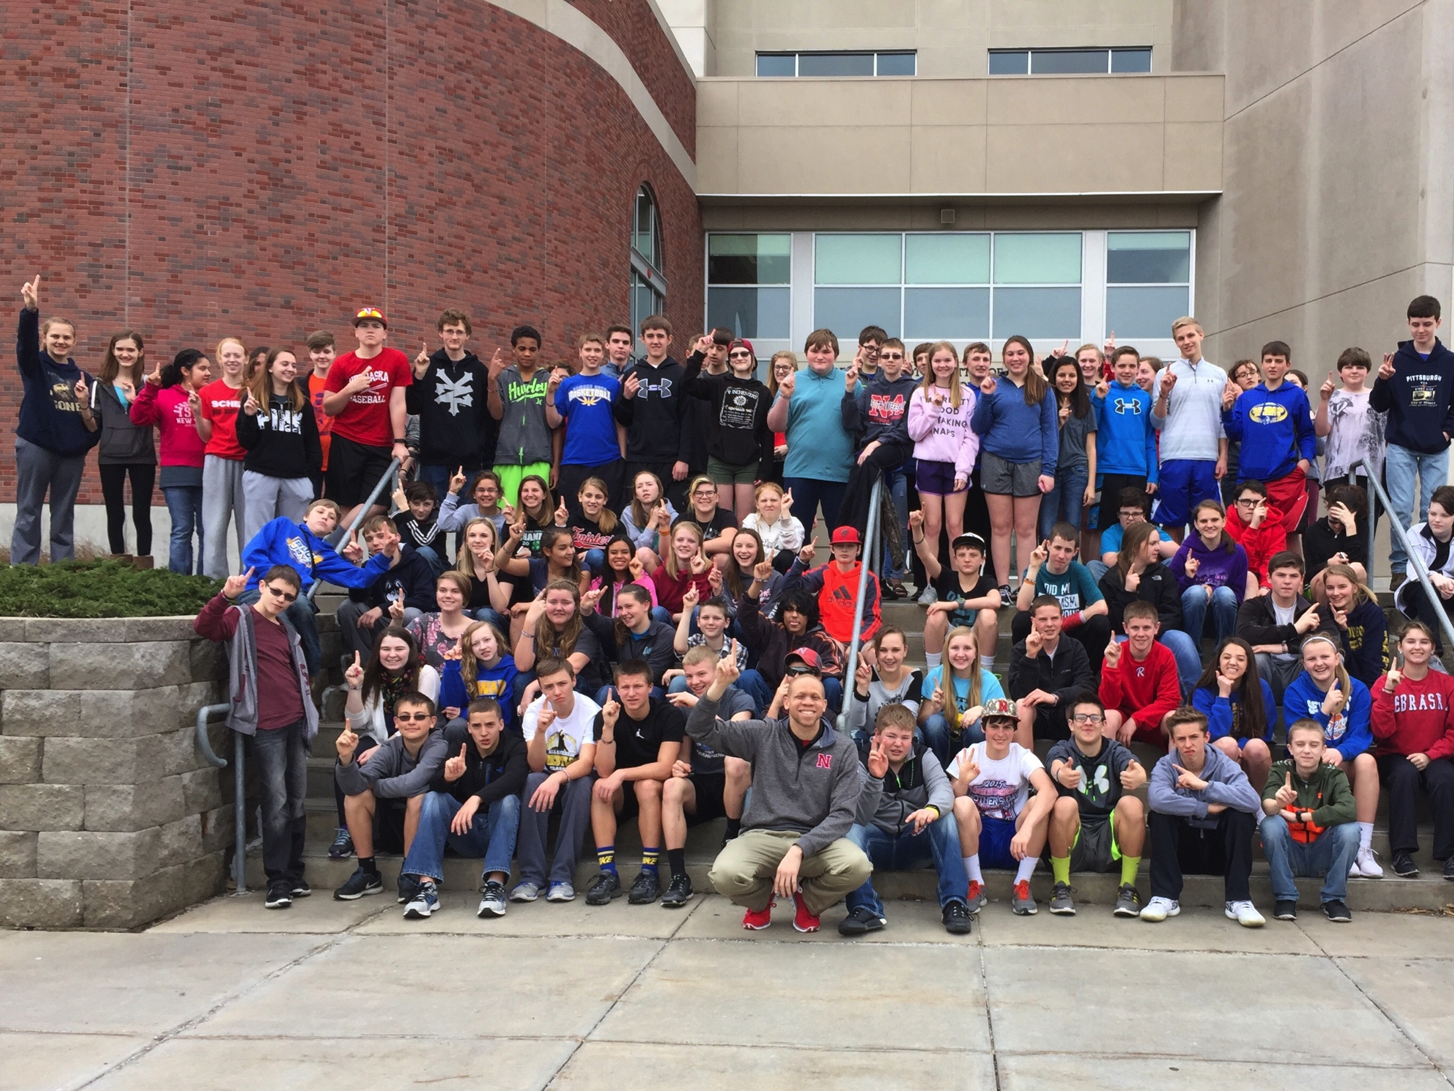
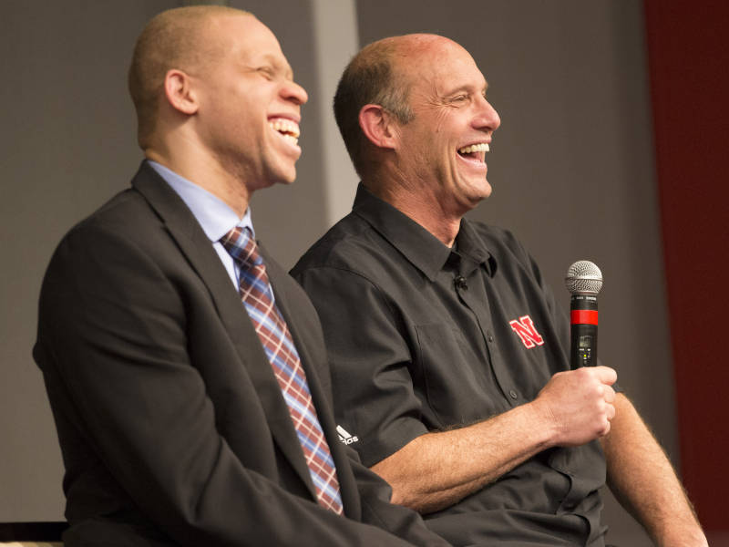
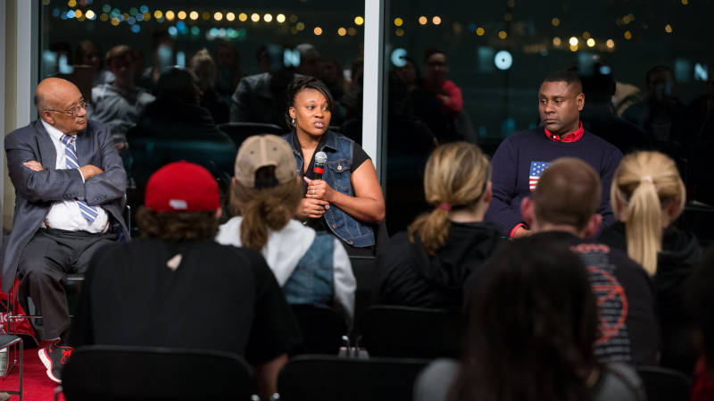
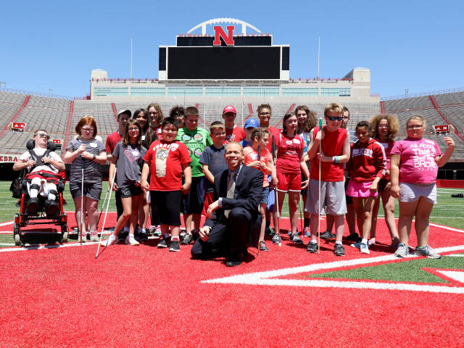
Questions?????

Slide 14
Lawrence Chatters, M.A. Diversity and Inclusion Consultant Nebraska Athletics Lchatters@huskers.com 402-730-3437

