Slide 1
IT Double Agent

Slide 2
Kristin Steiner
Tara Hughes

Slide 3
Tactical Friendliness: Everyone is an Asset

Slide 5
“The very best way in all the world to overcome self-consciousness and shyness is to get interested in other people and to think of them and, almost miraculously, your timidity will pass. Do something for other people. Practice deeds of kindness, acts of friendliness, and you'll be surprised to see what happens.” -Dale Carnegie

Slide 6
Squad Tradecraft: Perfecting Your Teamwork

Slide 8
"Teamwork is the ability to work together toward a common vision, the ability to direct individual accomplishments toward organizational objectives. It is the fuel that allows common people to attain uncommon results.“ - Andrew Carnegie

Slide 9
Target Fluidity: Adapting to Changing Circumstances

Slide 11
“In preparing for battle, I have always found that plans are useless but planning is indispensable.” -Dwight Eisenhower

Slide 12
Emotional Decryption: The Secret of Empathy

Slide 14
“In a world full of people who couldn’t care less, be someone who couldn’t care more.” -Kelly Corrigan

Slide 15
Conflict Resolution: What to do when your mission is compromised

Slide 16
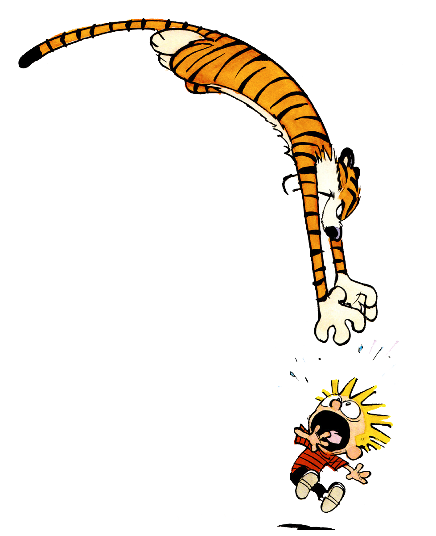

Slide 17
“The ultimate measure of a man is not where he stands in moments of comfort and convenience, but where he stands at times of challenge and controversy.” -Martin Luther King, Jr.

Slide 18
Situational Awareness: Using Intel to Your Advantage

Slide 20
“Awareness is a key ingredient in success. If you have it, teach it. If you lack it, seek it.”

Slide 21
