Slide 1
Cultivating Your Leadership
By Laura Hayden
Engineering IT, University of Illinois

Slide 2
“What got you here won’t get you there!”
-- Marshall Goldsmith

Slide 3
What is a Leadership Journey?
Redemptive Narrative
“shows that actively framing your narrative, helps adopt a positive identity that can lead to sharing more purposeful stories.”
--by Emily Esfahani Smith
A type of narrative

Slide 4
How do I dig-in?
The process begins with:
reflect back on your life
consider certain highs and lows
think about your beliefs and values
identify key moments that affected your journey

Slide 5
HIGHS
TIME
LOWS
Leadership Journey

Slide 6
HIGHS
TIME
LOWS
Leadership Journey

Slide 7
HIGHS
TIME
LOWS
Leadership Journey

Slide 8
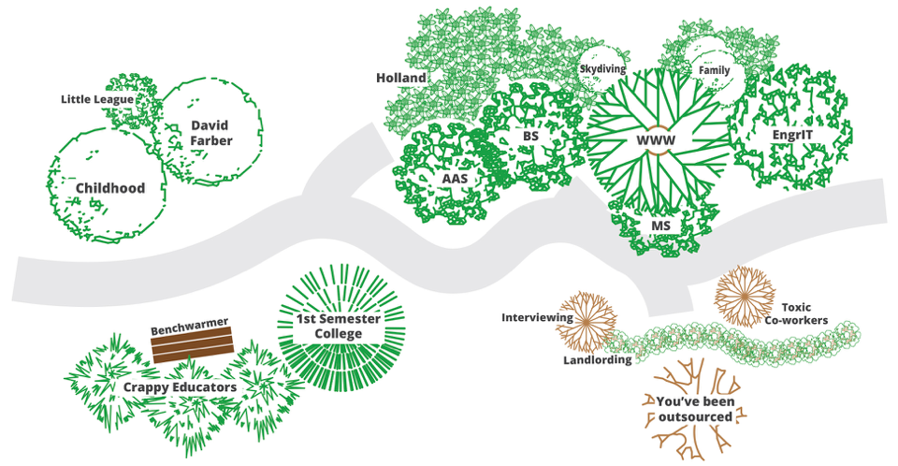
Cultivating Your Leadership

Slide 9
Cultivating Your Leadership

Slide 10
Cultivating Your Leadership

Slide 11
Expectations
Cultivating Your Leadership: Expectations

Slide 12
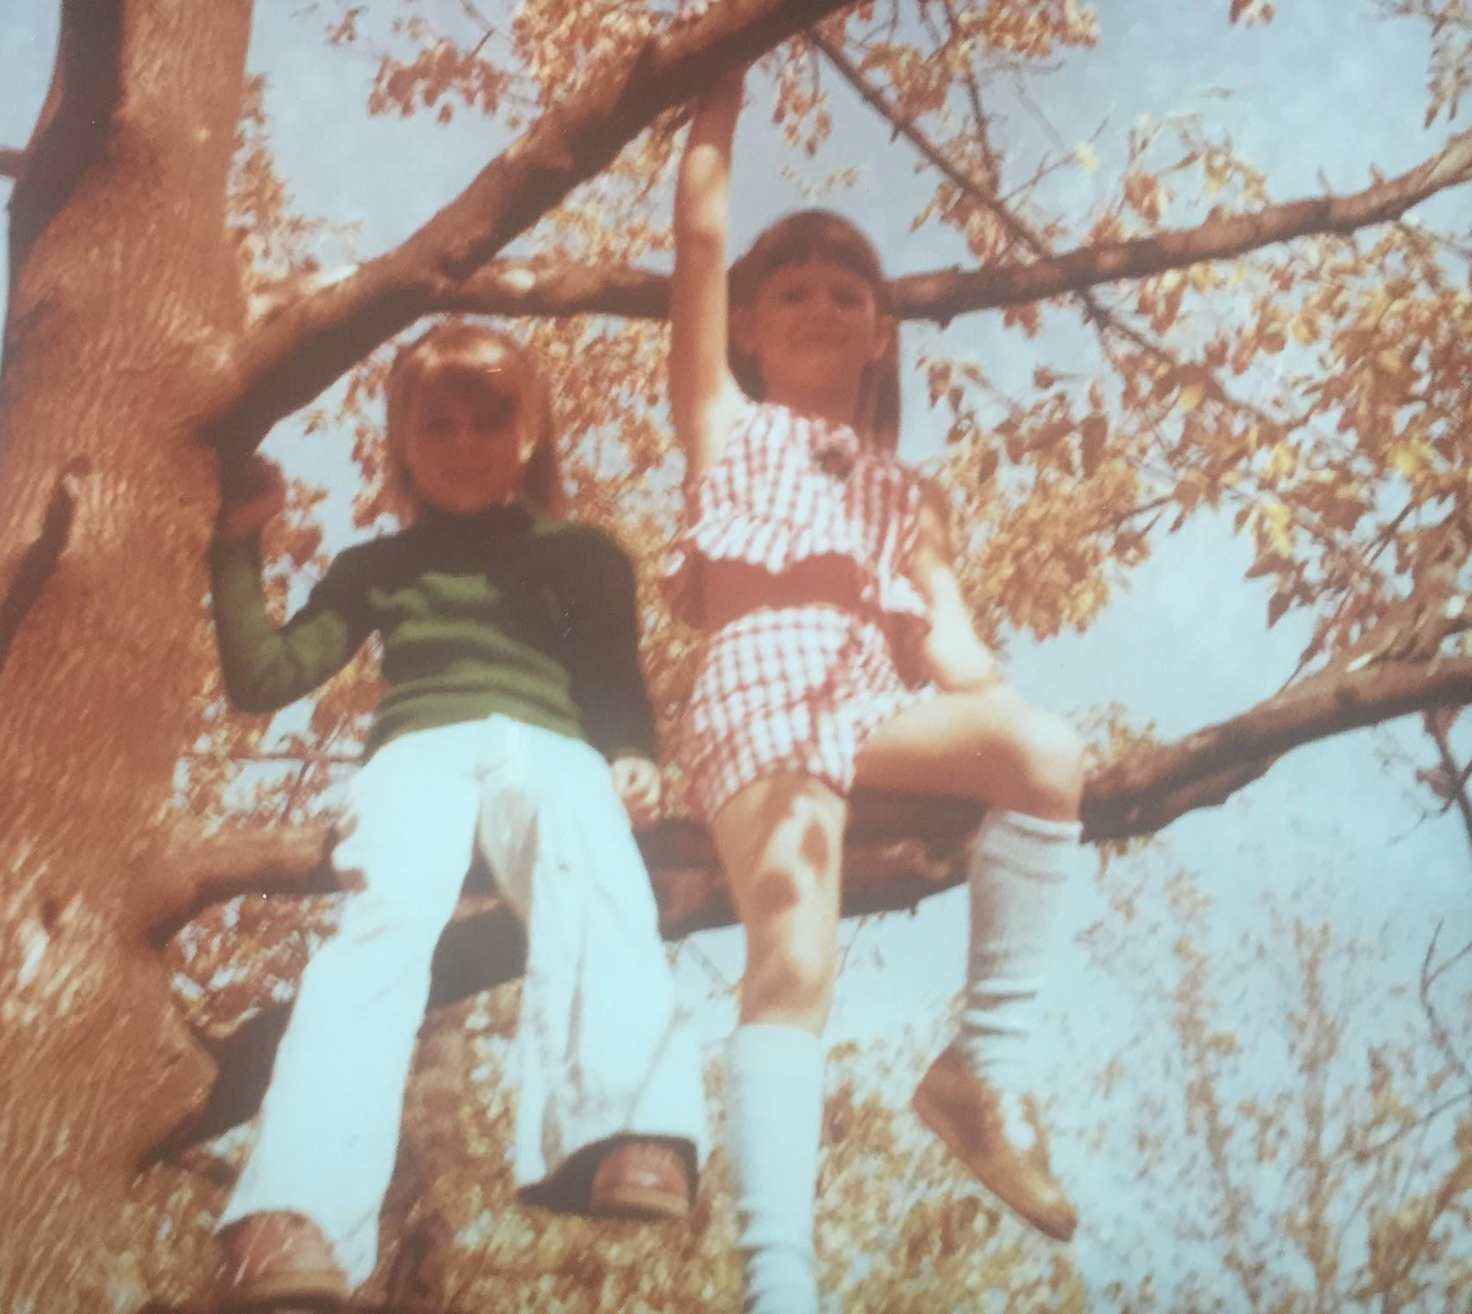
No limits!

Slide 14
The Importance of Giving Credit
There are no limits on how many individuals can be recognized for contributing to an outcome.
Credit is infinitely divisible.
...and it costs you nothing.
By --Sachin H. Jain
Notes:
The importance of giving credit https://hbr.org/2014/03/the-importance-of-giving-credit
Remember that there’s plenty of credit to go around. ..."credit is infinitely divisible” — in other words, there are no limits on how many individuals can be recognized for contributing to an outcome."
It can be diluted by blanket statements.

Slide 15
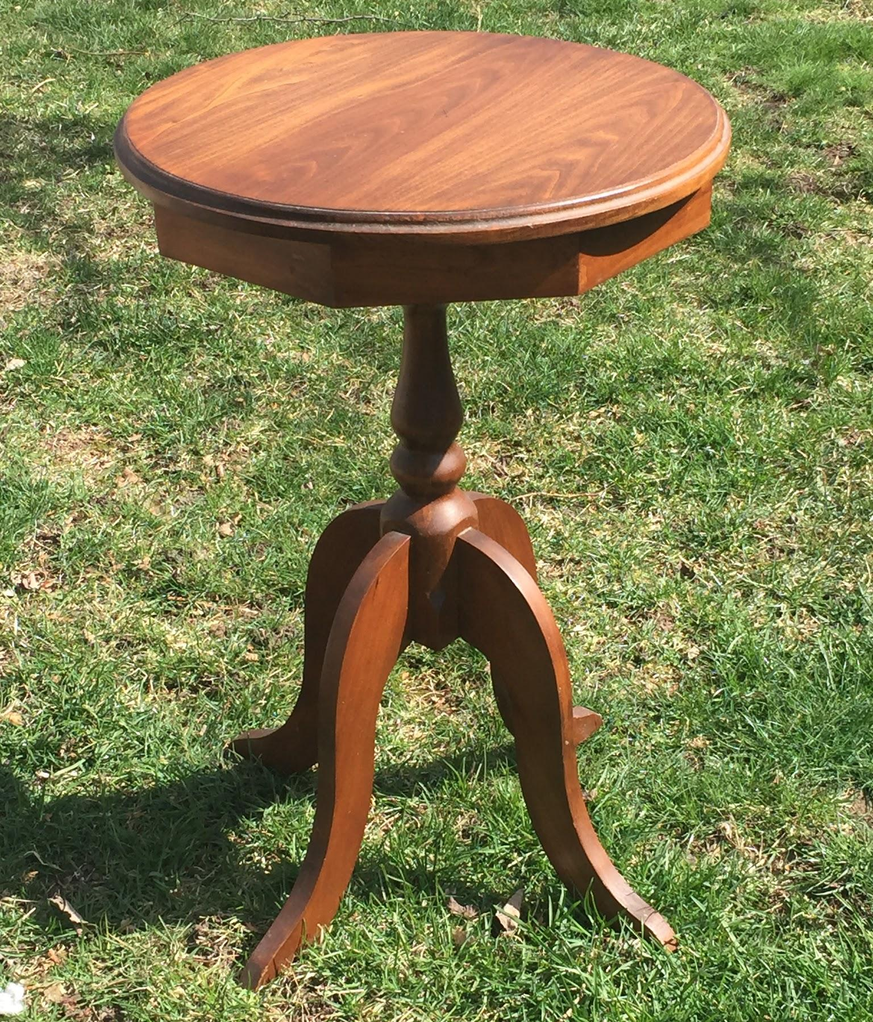
Leadership Lesson
Perseverance
Explore
Give credit

Slide 16
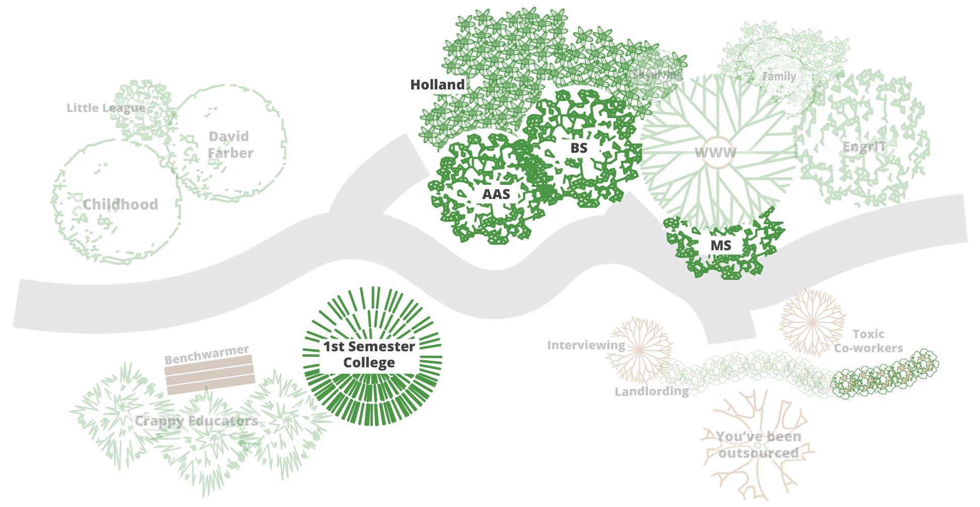
Education
Cultivating Your Leadership: Education

Slide 17
Suburban concrete
Leadership Journey as a Landscape
Google. Image capture Aug 2012 © 2017

Slide 18
Photo Credit: Mark Hart

Slide 19
Photo Credit: Laura Hayden

Slide 20
Photo Credit: Laura Hayden

Slide 21
Back to school

Slide 22
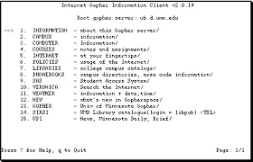
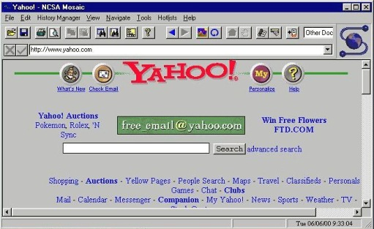
Welcome to the internet
Gopher: University of Minnesota
Mosaic: NCSA at the University of Illinois at Urbana-Campaign

Slide 23
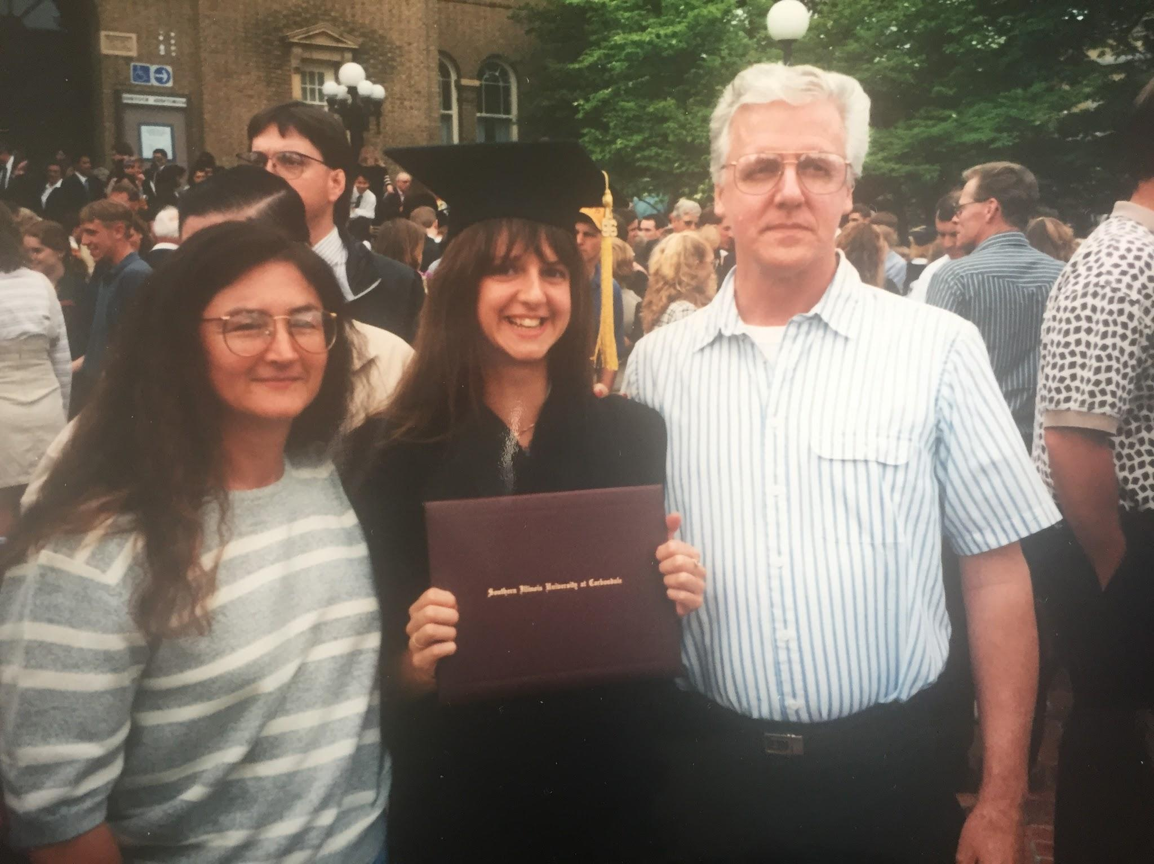
Graduation
Your education is a dress rehearsal for a life that is yours to lead.
--Nora Ephron

Slide 24
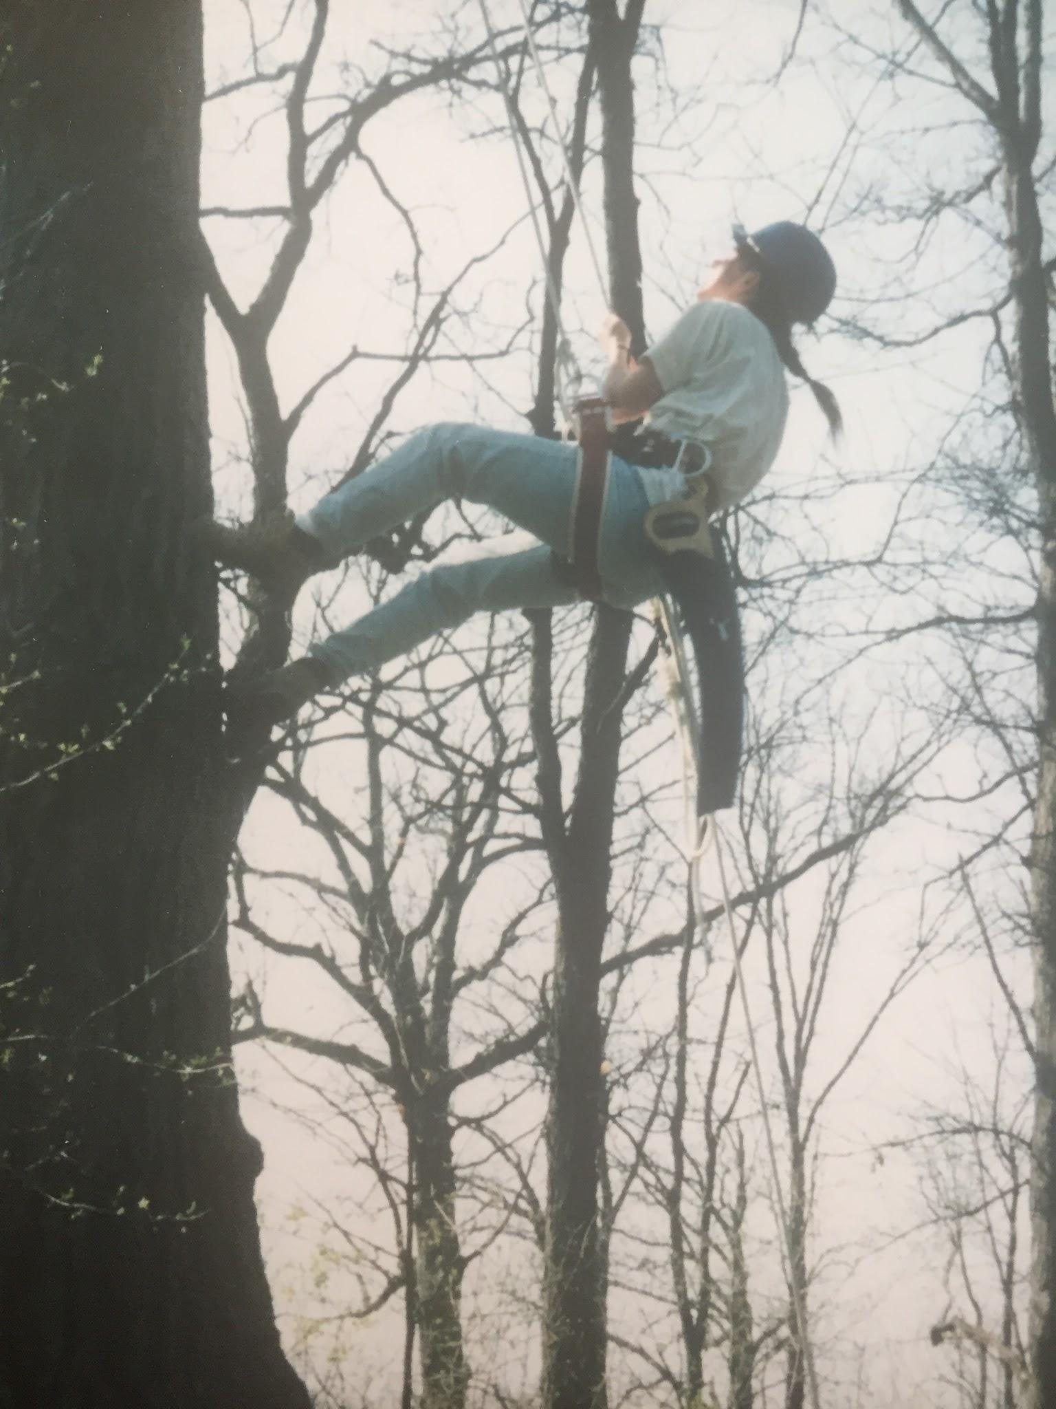

Slide 25
Leadership Lesson
You
Comfort Zone
Get out of your comfort zone.

Slide 26
Career
Cultivating Your Leadership: Career

Slide 27
Leadership Journey as a Landscape: Career

Slide 28
Leadership Lesson(s)
Bring your ‘A’ game
Presence Be intentional!
Show confidence & competence

Slide 29
Confidence
Confidence Blacklist
Over thinking
People pleasing
Inability of letting defeats go
Refusing to own an achievement
Luck
Perfection
Kay, Katty., and Claire Shipman. The Confidence Code
a feeling or belief that
you can do something well

Slide 30
Have perseverance Don’t set limits on your ability to explore
Take risks
Get out of your comfort zone
Have presence
Be intentional
Show confidence & competence

Slide 31
Cultivating your leadership is being intentional about how you want to lead and how you want to be seen as a leader.

Slide 32
Thank you.

Slide 33
Cultivating Your Leadership

