Slide 1
Are You Missing The Mark When You Benchmark?
WOMEN ADVANCING THE FUTURE OF INFORMATION TECHNOLOGY
IN HIGHER EDUCATION
University of Nebraska, 2017
NCWIT Summit on Women and IT
practices and ideas to revolutionize computing
May 22-24, 2017 | Tucson, Arizona
Dr. Brad McLain, NCWIT Research Scientist
Lifetime Partner: Apple Strategic Partners: National Science Foundation, Microsoft, Bank of America, Google, Intel, and Merck Investment Partners: Avaya, Pfizer, AT&T, Bloomberg, Hewlett Packard Enterprise, and Qualcomm

Slide 2
Benchmarking
What is it and
How Do YOU Do it?
Notes:
5 min kick-off table discussion with shout-out re-convene – to spark dialogue

Slide 3
What Is Benchmarking?
The collection and use of comparative data to describe and/or measure change (hopefully progress) over time.
Notes:
Comparative data: What kind of comparisons? Could be within an organization or across organizations or industry.

Slide 4
The Current “Measurement Narrative”
Notes:
Benchmarking is a powerful tool for helping to change this limited measurement narrative – claiming to assess the “diversity health” of an organization. But only if we understand what benchmarking is good for…

Slide 5
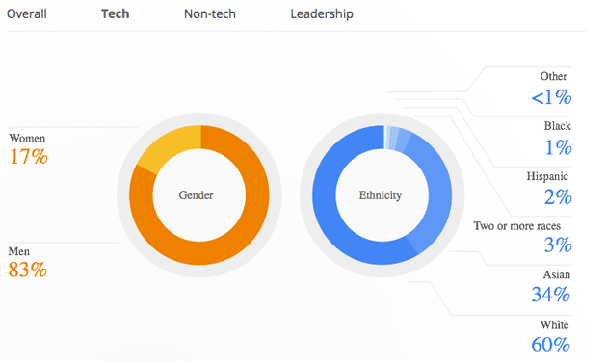
Nationally vs. Single Company
26% of Computing Workforce is women
2016, Department of Labor Bureau of Labor Statistics
Single Company Diversity Statistics
Notes:
This is what benchmarking usually amounts to… a comparison of head counts. For example, national averages vs single company stats. This is typically where it starts and where it ends.
This forms a call to action, of course. And that leads to goals setting and planning, but not always the BEST goals and plans.

Slide 6
Gender Diversity in Computing
GIRLS COMPRISE
22% of AP CS exam-takers
WOMEN EARN
17% of CIS degrees
In 1985, WOMEN EARNED
37% of CIS degrees
20% OF CS FAULTY
are women
Source IPEDS (included all not-for-profit, degree-granting institutions in the US)
Notes:
Bachelor’s Degrees
2014: About 14% male and female students completed CIS degrees who were a race other than White (including Asians)
2014: About 3% male and female students completed CIS degrees who were a race other than White (Excluding Asians)
Source IPEDS (included all not-for-profit, degree-granting institutions in the US)

Slide 7
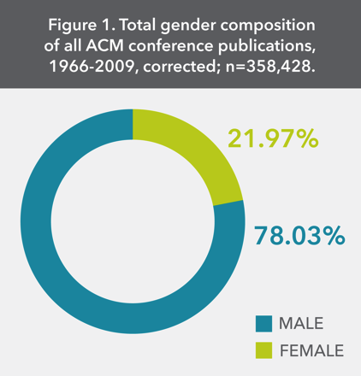
Impact On Innovation: ACM PAPERS
Conferences focused on Human Factors and on Documentation were associated with a greater proportion of women authors, while conferences on Algorithms were associated with a greater proportion of men authors.
Lowest - 10% - APL (Array Programing Languages)
Highest – 44% - SIGUCCS - University and College Computing Services
Cohoon, et.al., 1967 – 2009, CACM, August 2011
Notes:
ACM: Assoc. for Computing Machinery
SIGUCCS: Special Interest Group on University and College Computing Services (SIGUCCS) -- a community of IT professionals who help higher education institutions leverage current technology to foster discovery and learning.
What does this kind of benchmarking, or this kind of data NOT show?

Slide 8
Why Benchmark?
1. To set attainable strategic goals
2. To inform the best change leadership efforts for a given challenge and context
3. To gauge the efficacy of those efforts over time
Innovation
Notes:
And in the case of D&I --- we are seeking not only to achieve parity for social justice reasons, but also to maximize INNOVATION.
But in order to use benchmarking for these purposes – we have to go beyond headcounts and use data the tell a more complete story…. Let’s look at some examples of the kind of data we look at here at NCWIT …

Slide 9
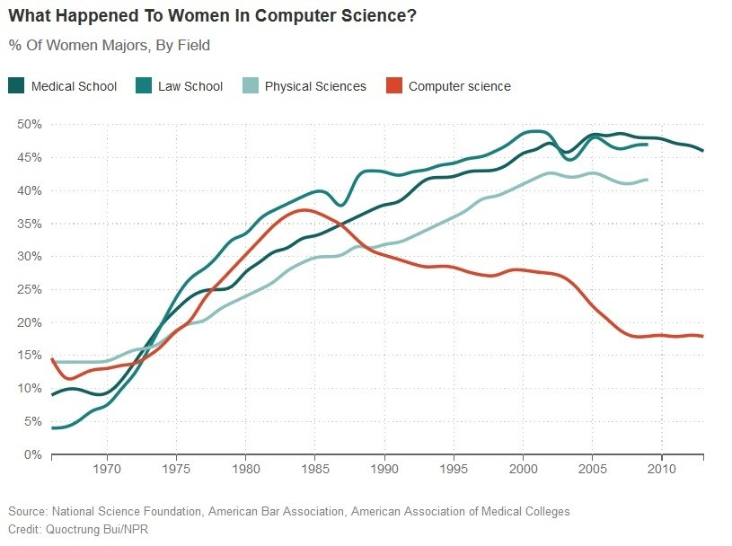
Why Benchmark?
Notes:
Frame as historical path of data and benchmarking
Head count data – striking, but one dimensional
This slightly older chart shows so-called “pipeline data” women undergrad % by major -- but is a good example of benchmarking against other fields .. Walk through it.

Slide 10
Who is doing it well?

Slide 11
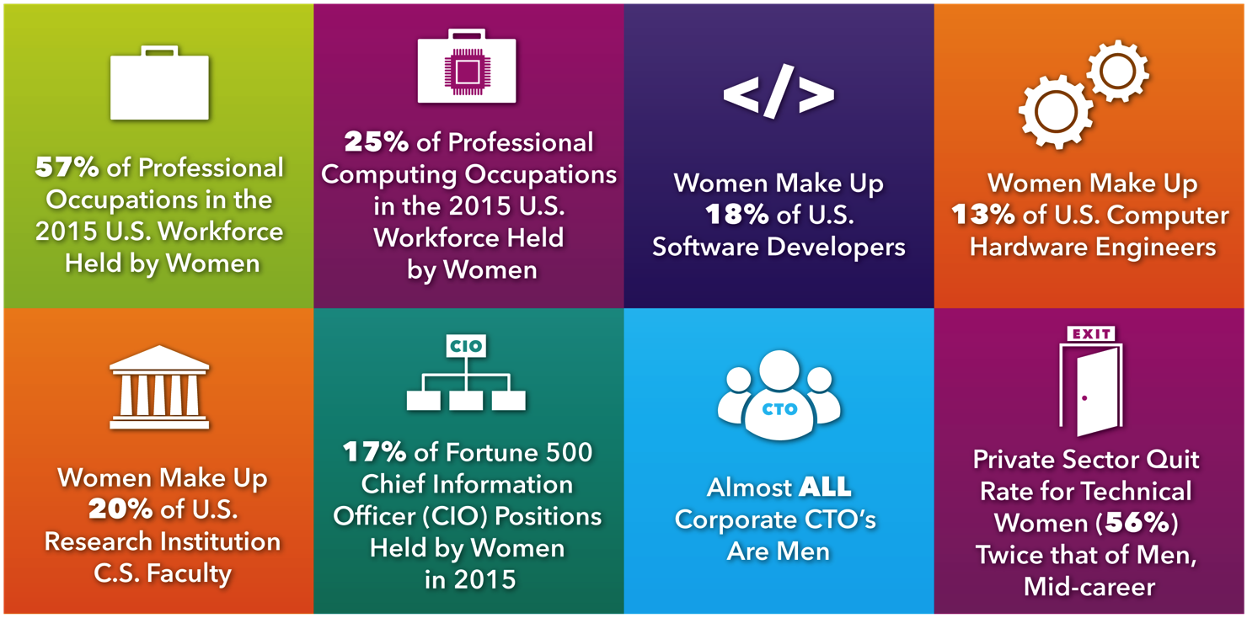
Department of Labor Bureau of Labor Statistics, Labor Force Characteristics by Race and Ethnicity 2015; Department of Labor Bureau of Labor, Employment by Detailed Occupation 2014 (Occupational Category: 15-1100); CRA Taulbee Survey
Notes:
14% metric from gartner on CTOs ….
Example of disaggregation: This is demographic representative data – a.k.a. Head count data again, important, but not to be used alone.

Slide 12
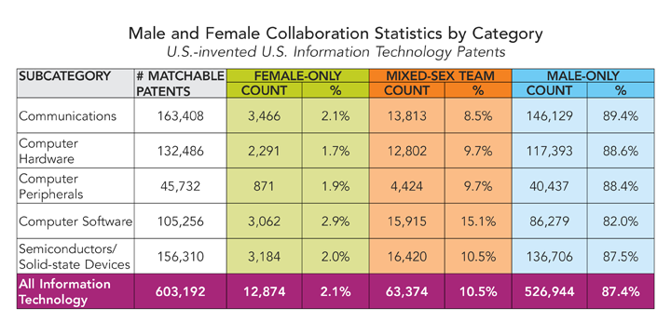
NCWIT – Who Invents IT? – 1980 - 2012
Notes:
This is sample data – where underrepresentation is revealed within different indicators – in this case, patents as a proxy for who is (and is not) in innovation roles in the tech sector.

Slide 13
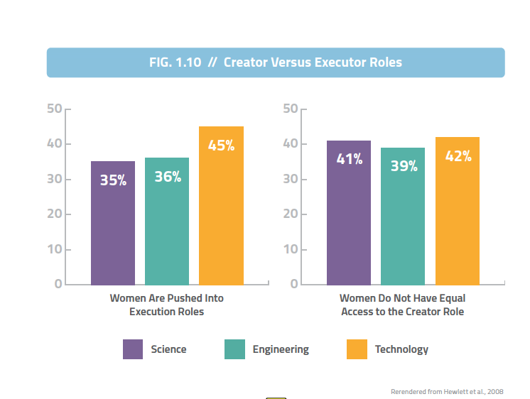
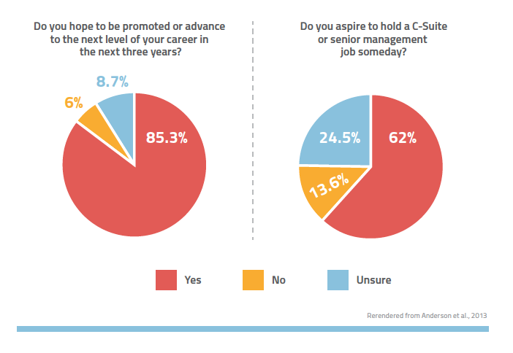
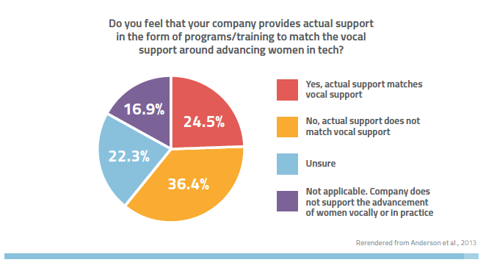
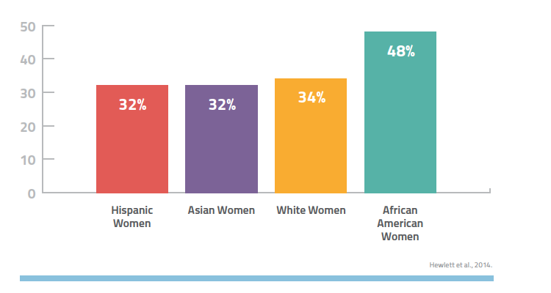
Notes:
And then we have different kinds of data – subjective data that reveals how people are thinking and feeling .
This allow us to go deeper and reveal what’s behind those awful patent data indicating who does and does not occupy creative roles.
Women report less access to creative & Innovative roles
Women have high aspirations for advancement
Women report low actual support for advancement (despite vocal support) – indicating a disconnect between women’s goals and company support
And then guess what – Women report feeling stalled in there careers

Slide 14
Bottom Lines:
Headcounts Are NOT Enough
And may be misleading alone
Don’t Confuse Indicators with Accomplishments
Conflation leads to confusion
ROOT CAUSE Needs To Be Addressed
Headcounts are only ONE KIND of Indicator
Cultural Change Requires MANY INDICATORS
Data & Benchmarking Should Tell a Story
Notes:
Don’t mistake slightly less horrible data than the next org as “good data” – (26% vs. industry average of 18% for example)
This is like confusing the symptoms with the disease, and thinking “if I could only get rid of the symptoms, then I’d cure the illness,”
Root Cause = ways unconscious bias manifests in tech culture

Slide 15
What is Your Story?

Slide 16
Inclusive Benchmarking Data Opportunities for Staff
Staff Recruiting and Hiring
Sourcing, Jobs Ads Language, Candidate Pools, Referrals, Interviewing, Selection Criteria
Mentoring & Sponsoring
People, Programs & Patterns
Task Assignment Patterns
Performance Review Policies vs. Practice
Advancement Criteria & Tracking
Culture & Climate Assessments
Diversity & Inclusion Effort Participation
Notes:
We need dis-aggregation to find the patterns – to know where the women are and where they are not, for example
Along with collecting and examining data in different ways comes importance of transparency and public disclosure of goals and numbers, which holds companies and leaders accountable

Slide 17
Inclusive Benchmarking Data Opportunities for Students
Applications
Tracking and trending
Admissions
Tracking, vetting, selection criteria, filtering processes, letter of rec,
Access to Mentoring and Sponsorship Opportunities
Curriculum
Topics embedded in assignments and examples
Lectures
Audience, examples, context, inclusion/exclusion
Pedagogy
Practices that limit opportunities for peer relationships and belonging
Notes:
Admissions
Selecting people “like us”; subtle criteria that disadvantage certain groups (e.g., overemphasis on extracurricular activities)
Assessment/Letters of Recommendation
Men with same qualifications appraised more highly; accomplishments attributed to effort, skill rather than collaboration, luck
Access to Networking/Sponsorship Opportunities
More difficult to connect with male faculty/leadersWe need dis-aggregation to find the patterns – to know where the women are and where they are not, for example
Along with collecting and examining data in different ways comes importance of transparency and public disclosure of goals and numbers, which holds companies and leaders accountable

Slide 18
Dis-Aggregation Opportunities
Intersectionality (gender + age, ethnicity, class, sexual orientation, more)
Across orgs, divisions, departments, teams
Job or internship titles (function and responsibilities)
Job levels (director, manager, individual contributor)
Salaries vs. Satisfaction
Longevity in major, org, or career track
Notes:
We need dis-aggregation to find the patterns – to know where the women are and where they are not, for example
Along with collecting and examining data in different ways comes importance of transparency and public disclosure of goals and numbers, which holds companies and leaders accountable

Slide 19
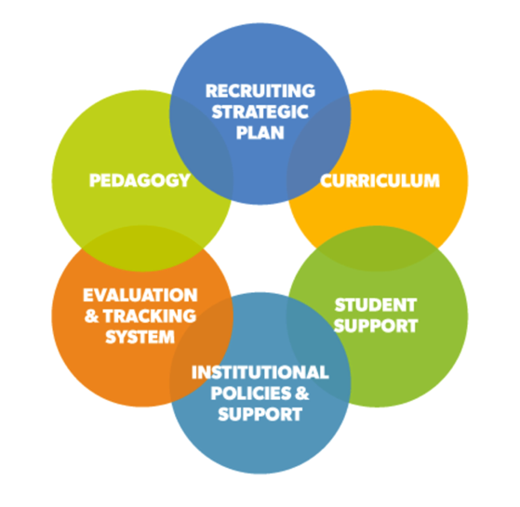

Slide 20
Steps Using Benchmarking
1. Take a Look in the Mirror
Know your own data & collect more where needed
Analyze your data from different perspectives
Know your culture: Norms, values, and people
Get Feedback

Slide 21
Steps Using Benchmarking
2. Set Attainable & Strategic Goals
Use both internal and external benchmarks
Identify indicators for progress
Get Feedback

Slide 22
Steps Using Benchmarking
3. Make a Plan
Use both internal and external benchmarks
Identify indicators for progress
Get Feedback

Slide 23
Steps Using Benchmarking
4. Evaluate with Regular Data Collection & Analysis
Establish accountability
Use mixed methods
Compare with internal benchmarks
Seek relevant benchmarks outside
Get Feedback
Notes:
Add in discussion about shifting narrative – beyond the numbers --- include innovation – use set up near beginning, the conclude with discussion

Slide 24
Shifting the Benchmarking Narrative
What Kind of Benchmarking Will Promote Innovation Through Diversity & Inclusion at YOUR instituion?

Slide 25
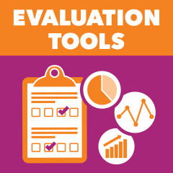
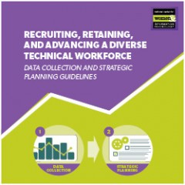
NCWIT Resources
ncwit.org/resources

Slide 26
Panel

