Slide 1
If Einstein had been a Woman
T. Marni Vos
Laughter’s Echo
Larry Weixelman
The University of Nebraska

Slide 2
Mary A. Albertson
Margaret Lindsay Huggins
Henrietta Swan Leavitt

Slide 5
Leadhership
A Kleinian Slip

Slide 6
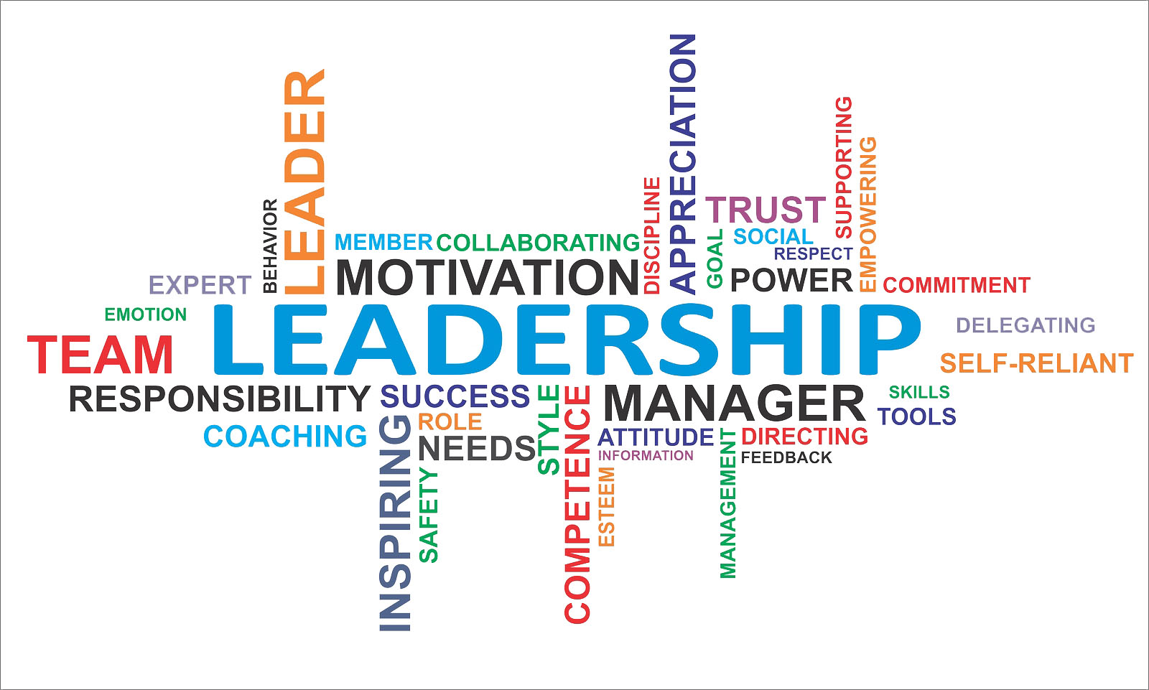

Slide 7
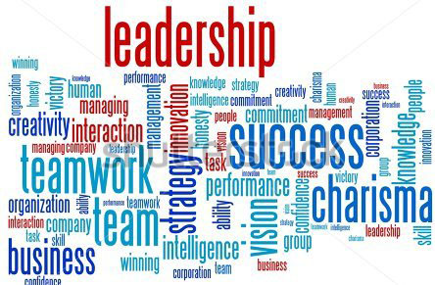

Slide 10
Components of Neutral Leadership Qualities
Humor
Creativity
Storytelling
Adaptability
Life Long Learning
Curiosity
Imagination
Shifting Perspective

Slide 11
Don Clifton
Founder
SRI-Gallup Organization

Slide 13
“In this groundbreaking book, maverick consultant, writer, and storyteller Annette Simmons applies the lessons of storytelling to management and leadership.”

Slide 14
Questions Welcomed

