Slide 1
REMOTE WORK:
Two Birds, One Stone
Credit: Quang Nguyen Source: https://dribbble.com/shots/4639677-Kill-Two-Birds-With-One-Stone
Notes:
Notes:
My name is April Goettle, I’m a web designer in Omaha and a senior in the IT Innovation Program at UNO.
I’m here today to talk about remote work, and why it’s important when we look at the state of technology jobs in the Midwest, especially in terms of diversity.

Slide 2
There are 700,000 unfilled tech jobs in the US. You want one of these jobs. But you don’t live in a tech hub. -or- Your company needs to fill one of these jobs. But the ideal candidate doesn’t live in the same city or state.
Notes:
Problem 1: – empty jobs, and no one to fill them. The department of labor estimates a 12% growth in tech jobs over the next 10 years. There was a recent article in the Omaha World Herald where HUDL discussed having to outsource high paying jobs because they can’t find qualified applicants within their community.
Remote work is still a new concept in the Midwest. Mature companies are entrenched in a 9-5 business model that says work has to happen in an office. Tech culture is still fresh and new in the Midwest, so even newer companies are sticking to this model. But it’s not working out, is it?
Source: https://www.cnbc.com/2019/06/18/there-are-70000-open-tech-jobs-here-is-how-firms-are-hiring-for-them.html According to a report by IT trade group CompTIA.
Omaha is not meeting its tech hiring goals – “Workforce Crisis” - recent article in the Omaha World Herald where Hudl describes the difficulty they have in hiring tech staff – outsourcing high paying jobs
Tech jobs take an average 2 months to fill and up to 6 months for cyber security: https://resources.workable.com/tutorial/time-to-hire-industry
Average relocation packages cost close to $20,000 https://www.moveline.com/moving-resources/corporate-moves-a-guide-to-negotiating-a-relocation-package

Slide 3
What about remote work?
SOURCE: https://www.techrepublic.com/article/rise-of-the-digital-nomad-why-working-remotely-could-draw-more-millennials-to-the-tech-industry/

Slide 4
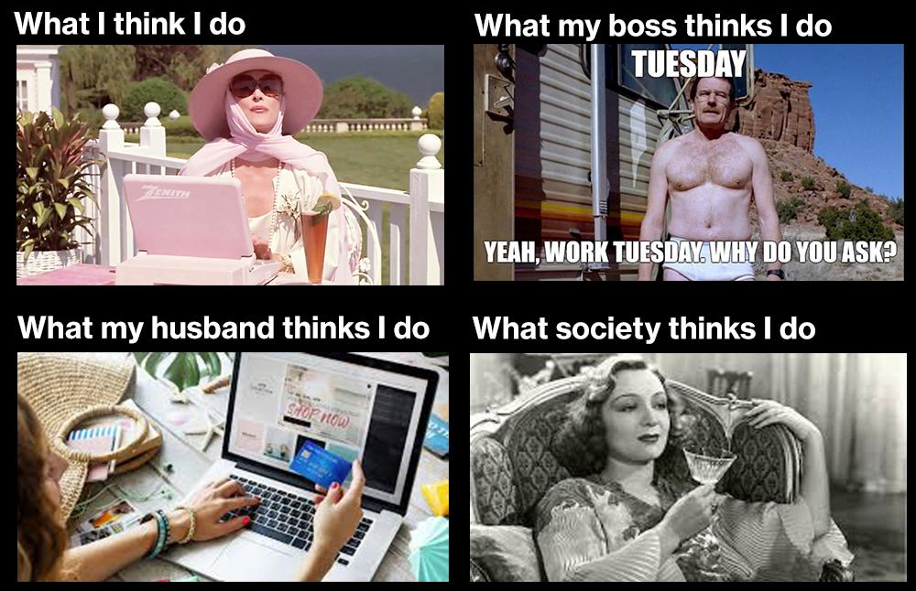

Slide 5
The typical “telecommuter” is a 49-year-old college graduate.
Reality:
Notes:
According to the Census Bureau

Slide 6
Why is Remote work good for companies?
Increased diversity
Wider hiring pool- this is a benefit that’s in demand
Increased productivity
Lower turnover rates
Lower costs for office space, utilities, supplies, coffee…
When it snows or floods, your company could still be providing service without disruption
Notes:
37% of tech workers saying they would switch to a job that gave them the ability to work off-site at least part of the time Source: https://news.gallup.com/businessjournal/204533/dream-job.aspx
Employee turnover can cost up to 30% of employee’s yearly salary to replace.
Sources: https://www.entrepreneur.com/article/333010

Slide 7
Why is Remote work good for employees?
Commuting is bad for your physical and mental health, expensive, & bad for the environment
Can provide a way to work while raising children, caring for family members, or dealing with chronic illness
Affordable housing/cost of living
Stop making Starbucks rich!

Slide 8
Why is Remote work good for communities?
Increase the overall health of the workforce by making work-life balance a little easier
Help increase diversity
Higher paying remote jobs can help to alleviate overpopulation and housing price issues in cities and help small communities stay viable
Help alleviate “brain drain”
Help slow the loss of small towns and farm communities
Notes:
Source: https://www.citylab.com/equity/2019/05/economic-geography-talent-brain-drain-research-map-move/588673/

Slide 9
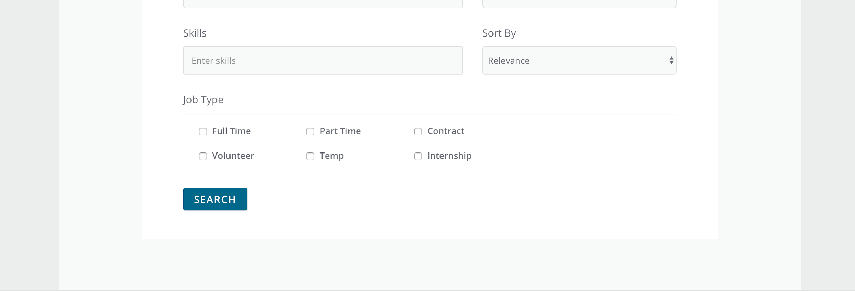
Remote work is a still a new concept in the Midwest
“Talent is equally distributed, opportunity is not.” – Leila Janah
Midwest does not have a remote work culture - yet
https://careerlink.com/search/advanced
Notes:
1. Leila Janah is CEO of Sama Group, a leader in the field of impact sourcing, a variation on traditional outsourcing that creates employment opportunities in low-income areas
2. Aim Career Link has no search function for remote or flex work

Slide 10
What can companies do?
What jobs can be opened up to remote candidates?
What current staff can work remotely?
Notes:
1. Leila Janah is CEO of Sama Group, a leader in the field of impact sourcing, a variation on traditional outsourcing that creates employment opportunities in low-income areas
2. Aim Career Link has no search function for remote or flex work

Slide 11
What can employees do?
Request remote or flex options from your current company
Look for remote work options at other companies
Add remote ready skills to your resume
https://careerlink.com/search/advanced
Notes:
1. Leila Janah is CEO of Sama Group, a leader in the field of impact sourcing, a variation on traditional outsourcing that creates employment opportunities in low-income areas
2. Aim Career Link has no search function for remote or flex work

Slide 12
What can communities do?
Remote work initiatives to attract or keep talent
Tax incentives for companies offering remote work
Support shared work space initiatives
Notes:
Source: https://www.marketwatch.com/story/cities-and-states-are-putting-out-the-welcome-mat-for-remote-workers-2019-10-15
What

Slide 13
What can education do?
Make tech degree programs available 100% online
Teach Current tech standards
Teach remote work skills
Notes:
Source: https://www.marketwatch.com/story/cities-and-states-are-putting-out-the-welcome-mat-for-remote-workers-2019-10-15
What

Slide 14
Resources:
REMOTER.TECH
REMOTEWOMAN.COM
FLEXJOBS.COM
REMOTE.CO
WEWORKREMOTELY.COM
REMOTEWORKHUB.COM
GOOD REFERENCES FOR COMPANIES:
Remote: Office Not Required, Jason Fried
https://ma.tt/2019/01/ted-the-future-of-work/

Slide 15
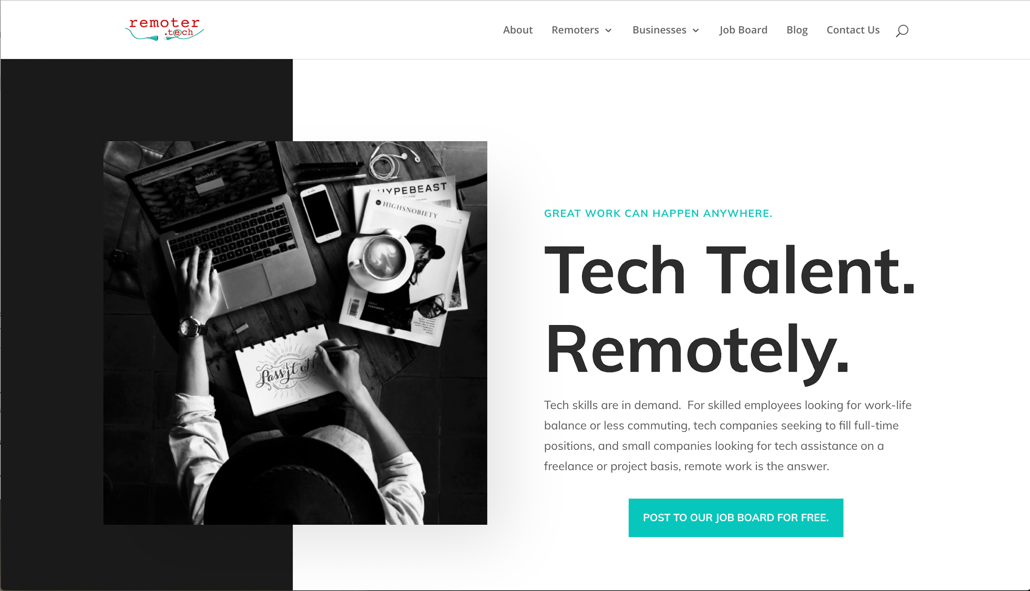
Notes:
Post a job, upload a resume, become part of the community and spread the word.

Slide 16
April@remoter.tech Instagram: @remoter.tech Facebook.com/remoter.tech/
Notes:
See website for direct links, also to Linkedin profile

