Slide 1
Incorporating Professional Development & Leadership Training for Women in STEM and IT
University of Nebraska at Omaha- WiSTEM Pro²
DeeDee Bennett, PhD
Kelly Gomez Johnson, EdD
Anne Karabon, PhD
Jenna Yentes, PhD

Slide 2
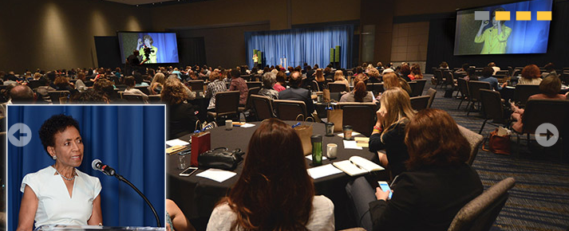
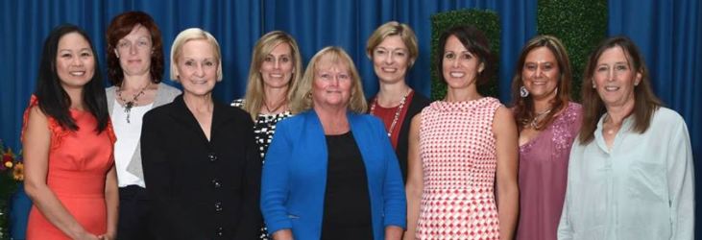
KU Medical Center: Women in Medicine & Science
2015 Women in Healthcare and Justice Conference
Keynote: Joan Williams, JD:
What Works for Women at Work
Over 400 attendees
Awards dinner and silent auction

Slide 3
2015 Searching for something in Nebraska…
UNL – Nebraska Women’s Leadership Network
UNMC – Women’s Mentoring Program
Creighton – WIMS, Committee on the Status of Women
UNO - Chancellor’s Commission on the Status of Women, WiSTEM student organization

Slide 4
What about your institutions?
Introduce yourself to a neighbor or two.
What organizations exist related to diversity on your campus?
What organizations exist which are aimed at women on your campus?
What faculty-driven organizations exist related to faculty development or promotion?

Slide 5
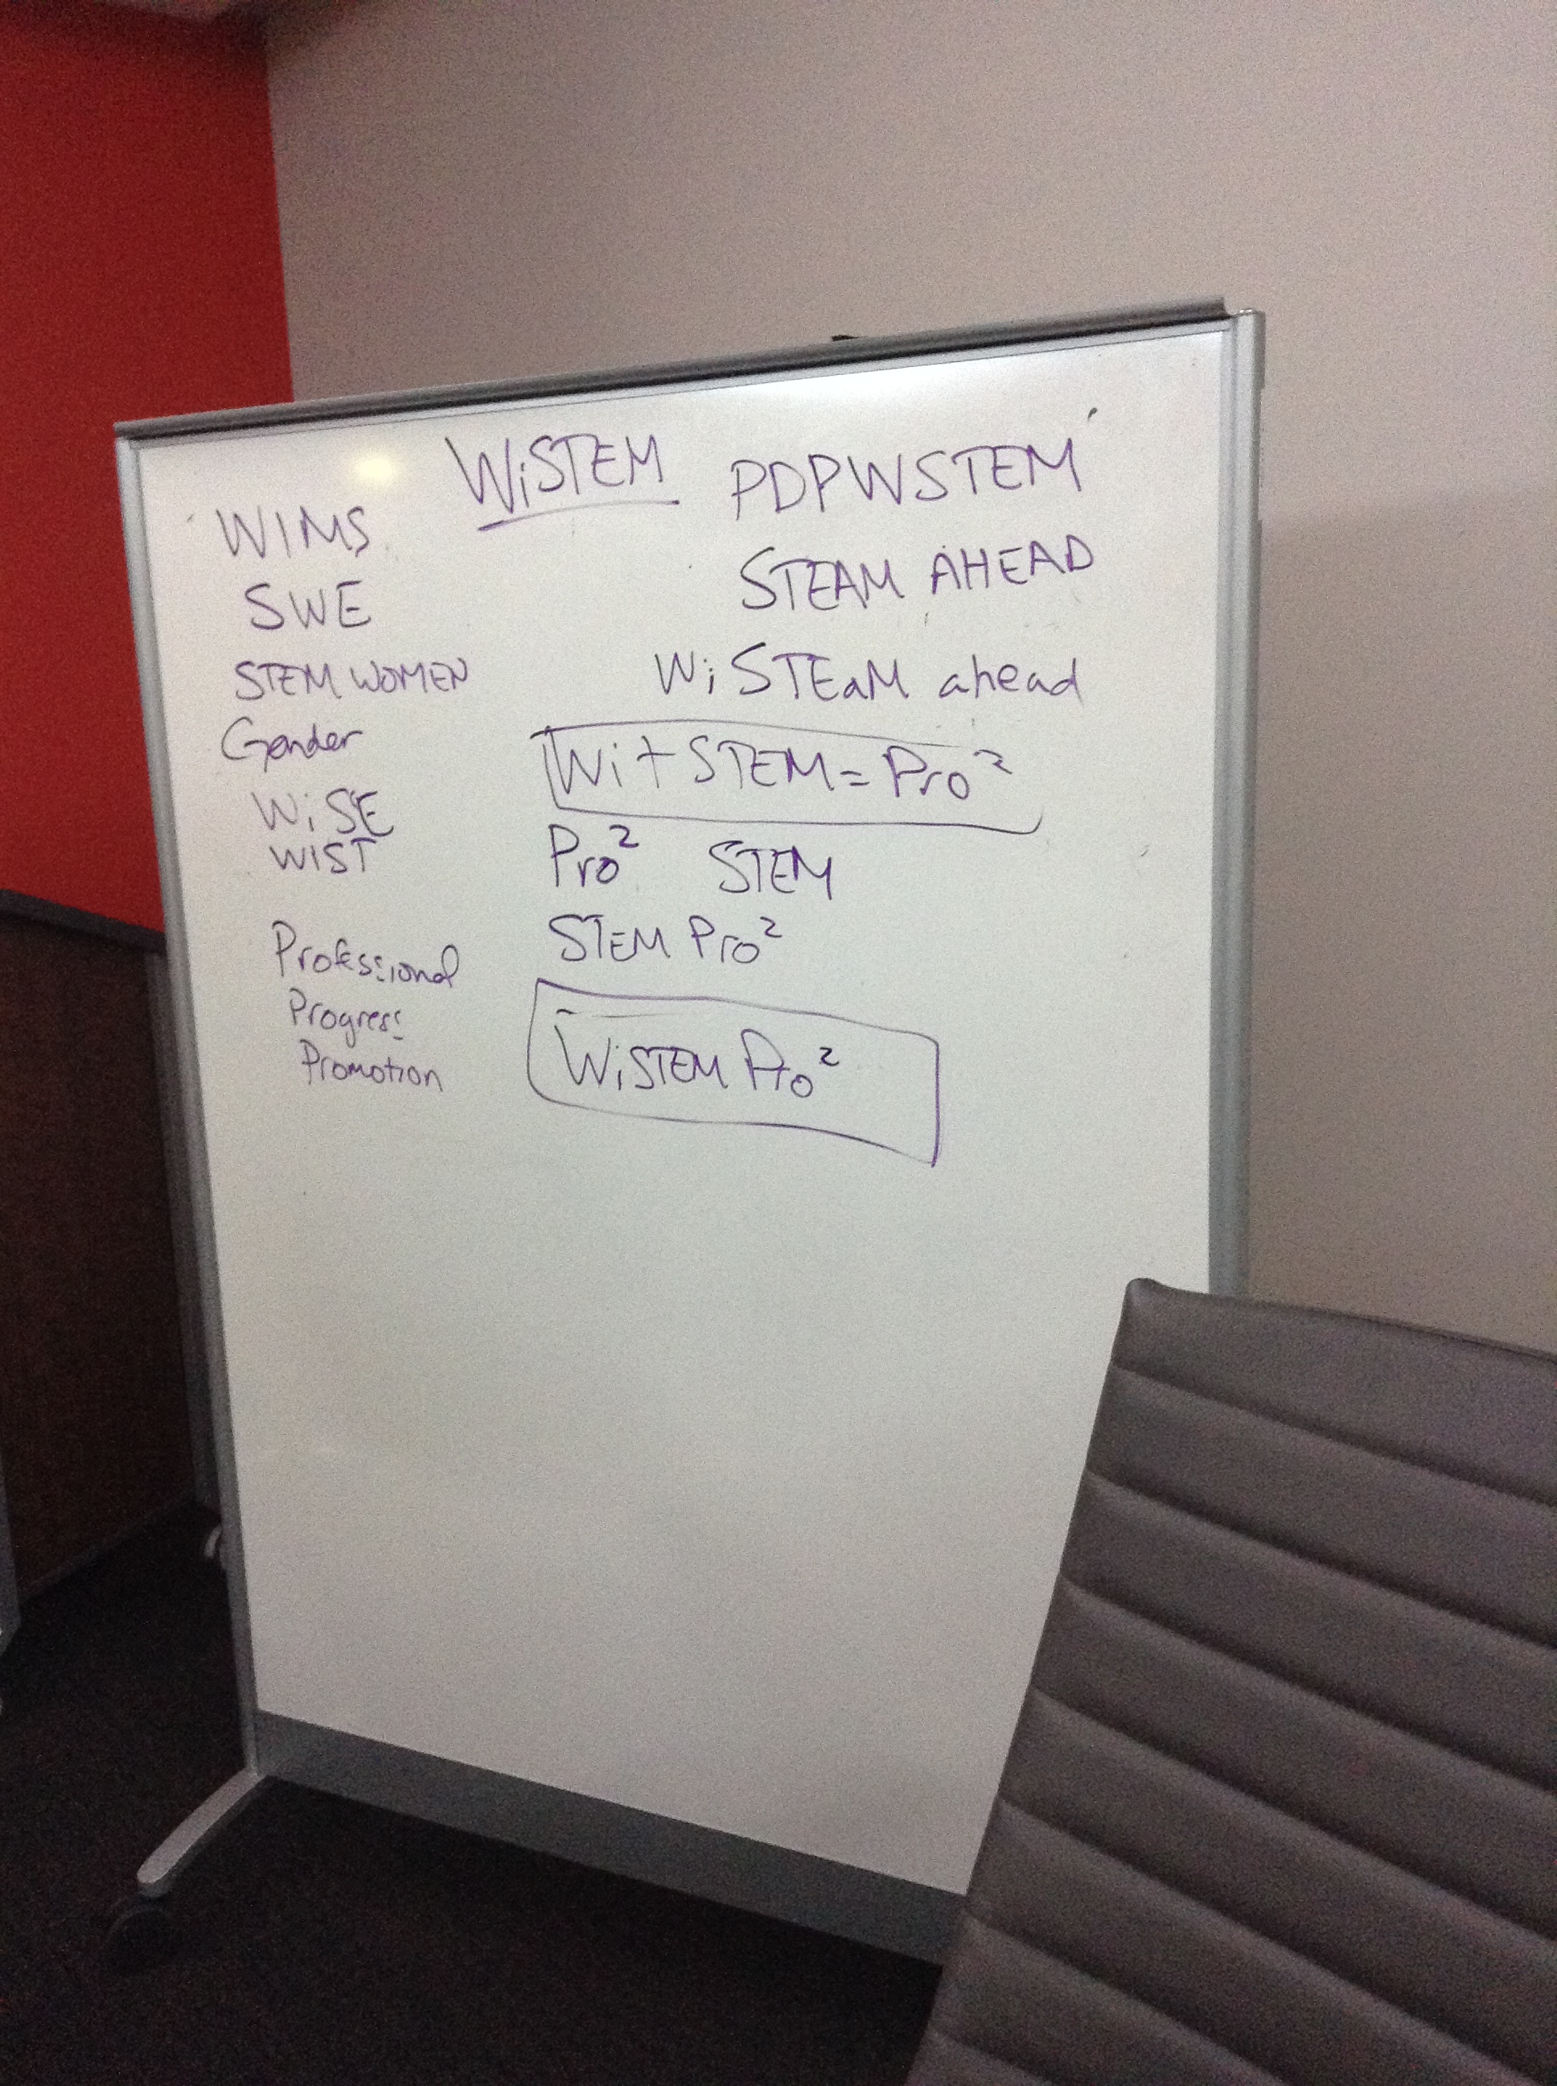
Name Chosen: WiSTEM Pro²

Slide 6
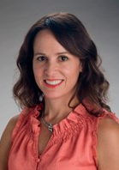
On the right path?
Paige Geiger, PhD
Founding members of KUMC WIMS
Toolkit: How to Start and Maintain a Robust WIMS Organization
Available through www.aamc.org

Slide 7
Mission & Goals Evolution
Before
WiSTEM Pro² is dedicated to the promotion of women in STEM through mentoring, continued dialogue, and professional development. The group is open to all individuals interested in advancing careers and educational opportunities for women in STEM. Our goals are: to advocate for the advancement of women in STEM support the WiSTEM student group continue professional development through mentoring and seminars retain women faculty and staff improve job satisfaction

Slide 8
Mission & Goals Evolution
After
WiSTEM Pro² is dedicated to the promotion of women in STEM through mentoring, continued dialogue, and professional development through collaboration across campus initiatives and engaging organizations. The group is open to all individuals interested in advancing careers and leadership opportunities for women. Our goals are: 1) to advocate for the advancement of women in STEM 2) continue professional development through mentoring and programming 3) retention of women faculty and staff 4) improve job satisfaction
What’s Missing from our previous version?

Slide 9
Fall 2016
Established Organization
White Paper
Spring 2017 Established Budget & Bylaws
Spring 2016 Formalize the group
Summer 2017
Annual Report & Secure Funding
The Plan

Slide 10
Direction & Goals for WiSTEM Pro²:
Promotion
&
Professional Development
Programming
Recognition & Awards
Data Collection & Research
Mentoring

Slide 11
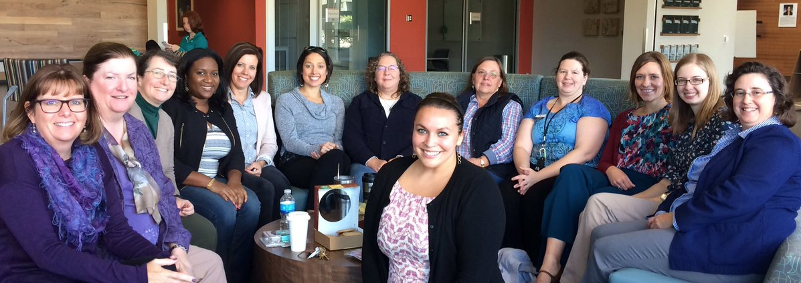
The Program Committee
Plans all events sponsored by the WiSTEM Pro²organization.
Campus Speakers
Meet and Greet Events
Networking Lunches
Book Clubs

Slide 12
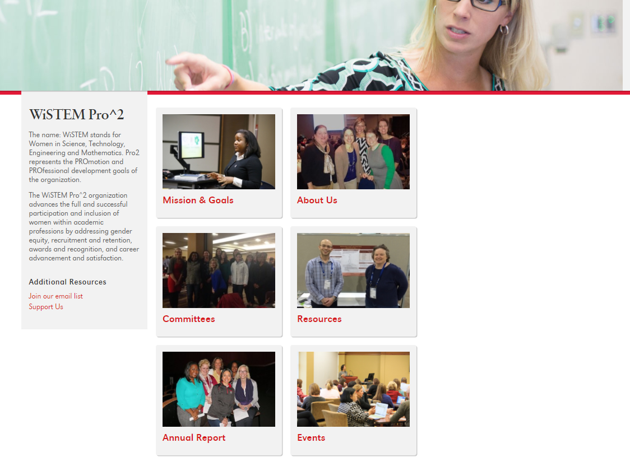
wistempro2.unomaha.edu

Slide 14
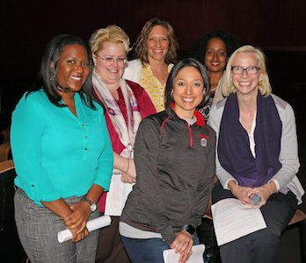
The Recognition and Awards Committee
Establish ways to recognize and honor women faculty, staff, and alumni of the University of Nebraska Omaha
Identify and organize available awards
Develop efficient nomination strategies
Advocate for women to be nominated for awards
Establish new awards and scholarships

Slide 15
The Data Collection & Research Committee
Investigate, collect, analyze metrics related to women faculty and staff in STEM fields at UNO
Utilize collected data to evaluate promotion and retention of women in STEM fields at UNO.
With the use of data collected, provide professional guidance and mentorship to members

Slide 16
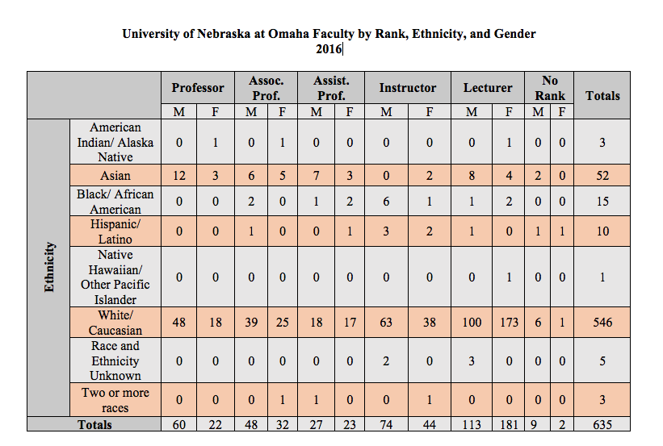
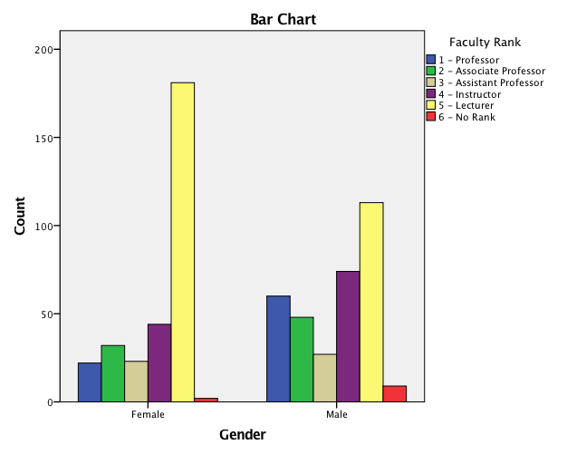

Slide 17
Reach Out
Budget
Support
Senior Leadership Support

Slide 18
Barriers
Over the past two years, we have identified the following:
Budget and Sustainability
How individuals identify themselves
STEM vs not-STEM
Lower-level buy in from faculty and staff
Participation and support

Slide 19
Programming Considerations
Broad to Specific
Partnerships & Funding
Getting our name out without misinforming
Promotion & Professional Development of Women in STEM

Slide 20
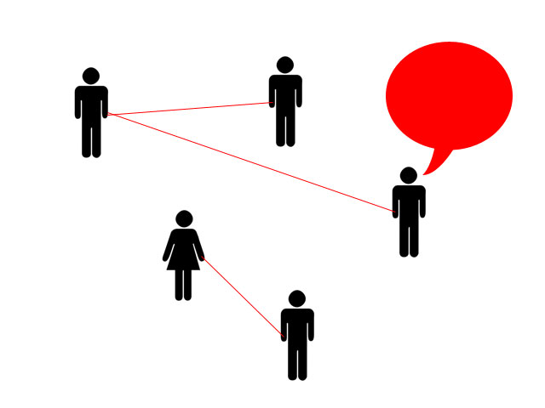
Our WiSTEM Pro² Network
New Faculty Connections
Administration Connections
Grant Collaborations
Cross-Curricular Collaborations
Research/Writing Collaborations
Celebrating Accomplishments
Leadership Opportunities

Slide 21
A Larger Network

Slide 22
Take Home With You
Contact us if you have questions
Reach out and ASK!
Be informed about what is, what is not available on your campus, in your office, etc.
Find someone else with a similar passion/desire for impact
wistempro2.unomaha.edu

Slide 23
Discussion
What might/does this look like at your institution?
How can you implement a group at your institution?
What might be the potential barriers? Opportunities?

Slide 24
Questions?
Jenna Yentes, PhD
Assistant Professor
Biomechanics
Past-President- WiSTEM Pro²
jyentes@unomaha.e
Kelly Gomez Johnson, EdD
Assistant Professor
Teacher Education- STEM
President- WiSTEM Pro²
kgomezjohnson@unomaha.edu
Anne Karabon, PhD
Assistant Professor
Teacher Education- ECE STEM
Committee Chair- WiSTEM Pro²
akarabon@unomaha.edu
DeeDee Bennett, PhD
Assistant Professor
Emergency Management
Committee Chair- WiSTEM Pro²
dmbennett@unomaha.edu

